Slide 1
Economic Variable Correlation and Productivity Model
By:
Opeyemi Fayipe
opeyemifayipe@gmail.com

Slide 2
Objective
The objective of this project is to conduct a financial analysis to explore the correlations between key economic variables and develop a productivity model for the USA. The analysis will help to understand how changes in these variables affect overall economic productivity and to determine the real currency devaluation.

Slide 3
Key Economic Variables
M1 Money Supply:
Definition: M1 includes the most liquid forms of money, such as cash and assets that can quickly be converted to currency. It typically includes physical currency, demand deposits, traveler's checks, and other checkable deposits.
Importance: An increase in the money supply can stimulate economic growth by encouraging spending and investment. However, excessive growth in the money supply can lead to inflation.
Real Exchange Rate (Black Market):
Definition: The real exchange rate adjusts the nominal exchange rate by relative price levels between two countries, reflecting the actual purchasing power of a currency.
Importance: The real exchange rate affects international competitiveness. A lower exchange rate can boost exports by making a country's goods cheaper for foreign buyers, but it can also increase the cost of imports, contributing to inflation.

Slide 4
Key Economic Variables
S&P 500 Index (Adj Close):
Definition: The S&P 500 is a stock market index tracking the performance of 500 large companies listed on stock exchanges in the United States. The adjusted close price accounts for dividends, stock splits, and other adjustments.
Importance: The S&P 500 Index is a key indicator of the overall health of the stock market and investor confidence. It reflects the performance of major companies and is often used as a benchmark for the performance of investment portfolios.
Inflation Rate (CPI):
Definition: The Consumer Price Index (CPI) measures the average change over time in the prices paid by urban consumers for a market basket of consumer goods and services.
Importance: Inflation erodes purchasing power and can affect economic stability. Central banks monitor inflation closely to adjust monetary policy, aiming to keep it within a target range to ensure stable economic growth.

Slide 5
Importance of the Analysis
By analyzing the correlations between these variables, we aim to:
Understand the interplay between money supply, exchange rates, stock market performance, and inflation.
Develop a productivity model that quantifies economic productivity based on these variables.
Assess the impact of currency devaluation on economic stability.

Slide 6
Theoretical Framework
The analysis is based on the following theoretical framework:
Increased Money Supply:
Leads to currency depreciation as more money circulates in the economy.
Can boost stock market performance due to increased liquidity and investment.
Can increase inflation as higher money supply boosts demand for goods and services.
Currency Devaluation:
Makes exports cheaper and imports more expensive, affecting trade balances.
Contributes to inflation as import prices rise.
3. Stock Market Performance:
Reflects economic growth and investor confidence.
Can be influenced by changes in money supply and inflation rates.
4. Inflation:
Affects purchasing power and cost of living.
Can be driven by changes in money supply and exchange rates.

Slide 7
Economy Variable Visualization
M1 Money Supply Chart
Real Exchange Rate Chart
S&P 500 Index Chart
Inflation Rate Chart

Slide 8
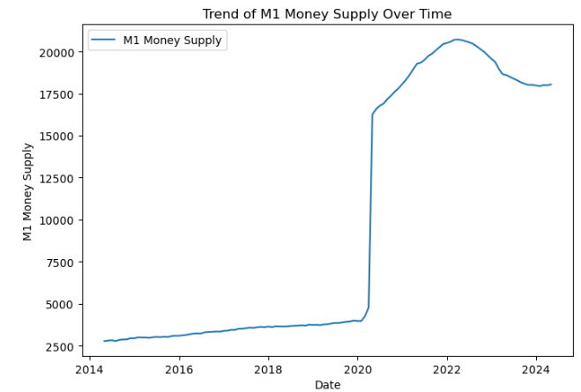
M1 Money Supply:
Trend: There is a consistent upward trend in the M1 Money Supply from 2014 to 2024.
Interpretation: This indicates that the amount of liquid money (cash and checking deposits) in the economy has been increasing steadily over the past decade. A growing money supply can be associated with economic growth but might also lead to inflation if it grows too quickly.

Slide 9
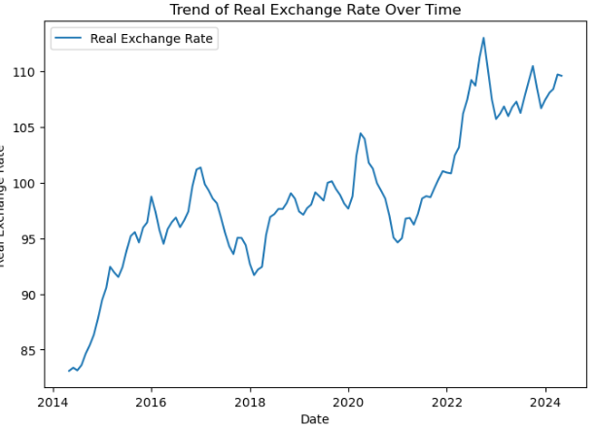
Real Exchange Rate:
Trend: The real exchange rate shows some fluctuations but generally trends upward from 2014 to 2024.
Interpretation: An increasing real exchange rate suggests that the domestic currency is appreciating in real terms. This can affect international trade, making exports more expensive and imports cheaper, which might impact the trade balance.

Slide 10
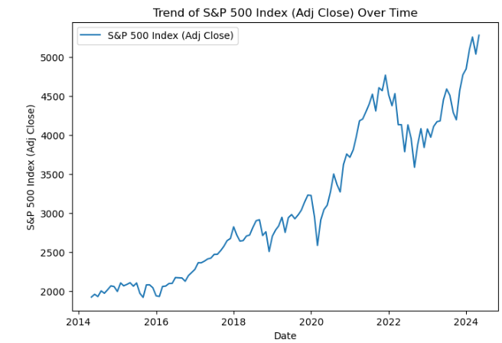
Stock Market (S & P 500 Index (Adjusted Close):
Trend: The S&P 500 Index has a strong upward trend, with significant growth from 2014 to 2024.
Interpretation: The rise in the S&P 500 Index indicates a bull market with increasing stock prices. This suggests investor confidence and economic growth, as stock markets often reflect the overall economic conditions and corporate profitability.

Slide 11
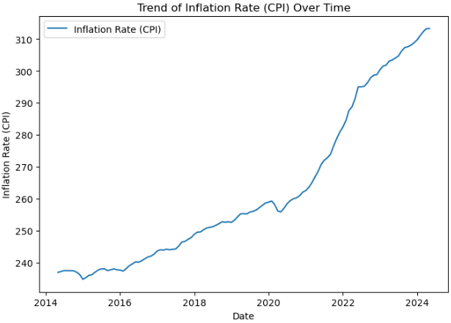
Inflation Rate(Consumer Price Index)
Trend: The Consumer Price Index (CPI) shows a steady increase over time.
Interpretation: A rising CPI indicates that the general price level of goods and services in the economy is increasing, which is a sign of inflation. Moderate inflation is typical in a growing economy, but high inflation can erode purchasing power and savings.

Slide 12
Summary of Trends
Economic Growth: The upward trends in M1 Money Supply, S&P 500 Index, and the Real Exchange Rate suggest that the economy has been expanding.
Inflation: The consistent increase in the CPI indicates ongoing inflation, which is a common byproduct of economic growth and an increasing money supply.
Currency Appreciation: The upward trend in the Real Exchange Rate indicates that the domestic currency has been appreciating, which could influence international trade dynamics.
These visualizations provide a high-level overview of the economic conditions over the past decade, highlighting trends in money supply, currency value, stock market performance, and inflation. For a more detailed analysis, further statistical methods and economic models could be applied

Slide 13
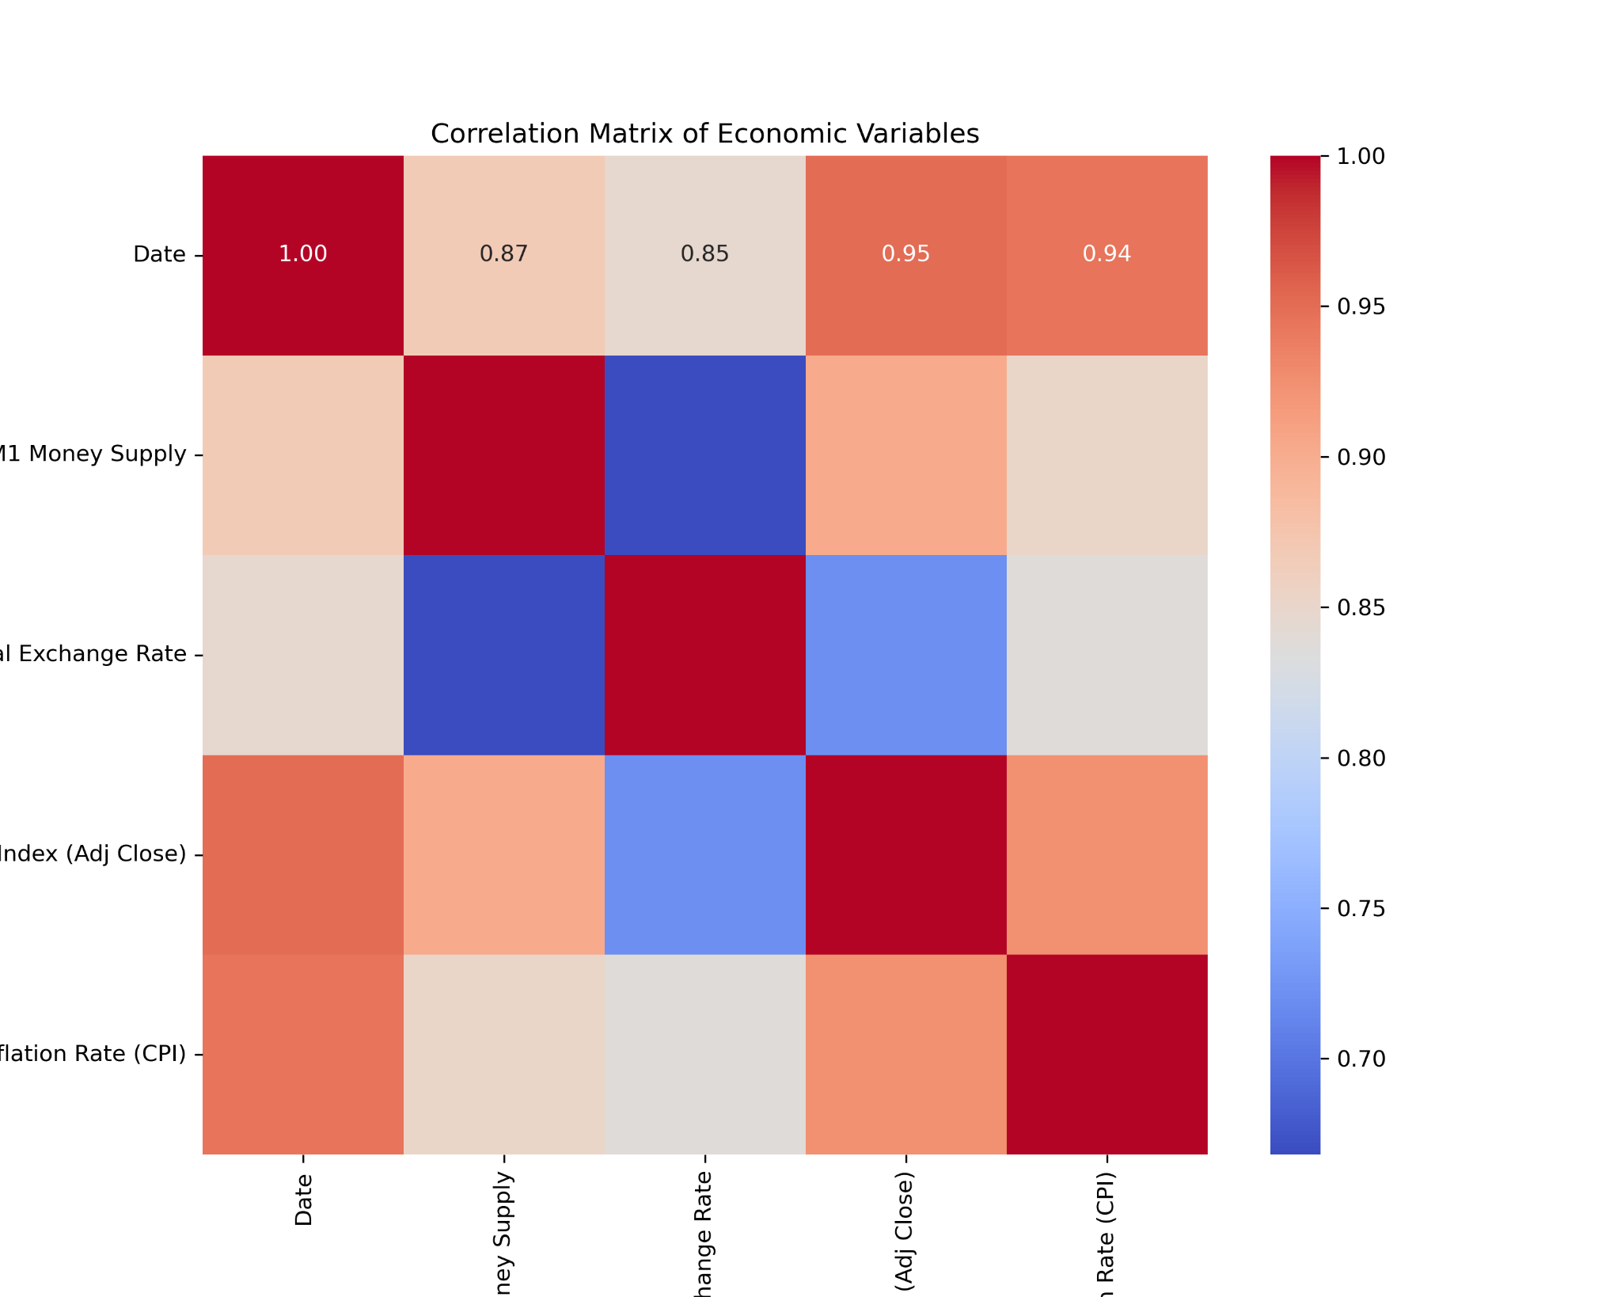
Overall insights
General Trend: All variables are positively correlated with each other and with the date, indicating a general upward trend over time.
Strongest Relationships: The strongest relationships are observed between the S&P 500 Index and Inflation Rate, and between the S&P 500 Index and M1 Money Supply.
Economic Interpretation: The positive correlations among these economic indicators suggest that they tend to move together, reflecting broader economic conditions where increases in the money supply, stock market performance, exchange rates, and inflation are interconnected.

Slide 14
Summary
The observed correlations support the following theoretical assertions:
Increased money supply leads to higher inflation and currency depreciation.
Currency depreciation is associated with higher inflation.
The stock market tends to appreciate with increased money supply, potentially due to increased liquidity and investment flows.
These relationships provide a framework to understand how monetary policy and economic variables interact and affect productivity and overall economic health.

Slide 15
Theoretical Framework
Based on these correlations, we can theorize the following:
Increased Money Supply:
Leads to currency depreciation (reflected in the positive correlation with the real exchange rate).
Contributes to stock market appreciation (though stock market data isn't directly included here, it's typically related to money supply increases).
Results in increased inflation (as seen in the strong positive correlation).
These relationships align with economic theories where an increase in money supply can lead to inflation and currency depreciation.

Slide 16
Productivity Model
Productivity is calculated as:
'Productivity' = selected_columns(S&P 500 Index (Adj Close)'] / Inflation Rate (CPI) * Real Exchange Rate'])
This formula essentially tries to normalize the stock market index by both inflation and the real exchange rate, which can give a sense of how the stock market is performing relative to these economic factors.
Date | Productivity
2014-05-01 | 0.097703
2014-06-01 | 0.099100
2014-07-01 | 0.097777
2014-08-01 | 0.100905
2014-09-01 | 0.098135
The productivity values are relatively stable over the first few months shown, with slight fluctuations.
First Few Rows of Productivity

Slide 17
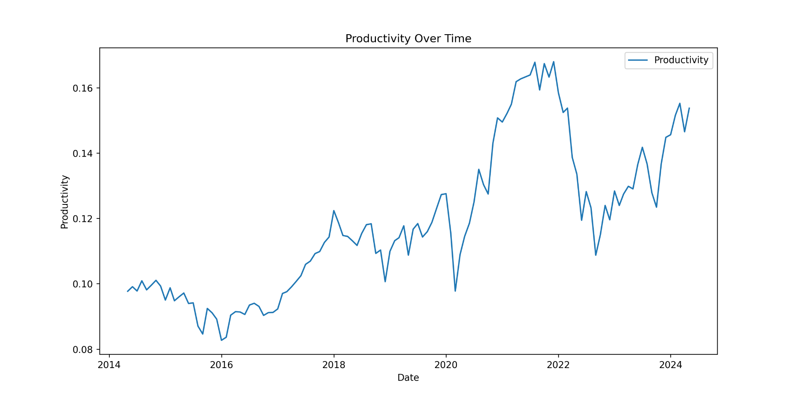
Line Graph of Productivity Over Time
Trend: This graph shows the productivity index over time, from 2014 to 2024.
Observations:
2014-2017: Relatively stable with minor fluctuations.
2017-2019: Gradual increase in productivity.
2019-2021: Noticeable increase with some volatility.
2021-2024: Significant spikes and drops, showing higher volatility but generally trending upwards.

Slide 18
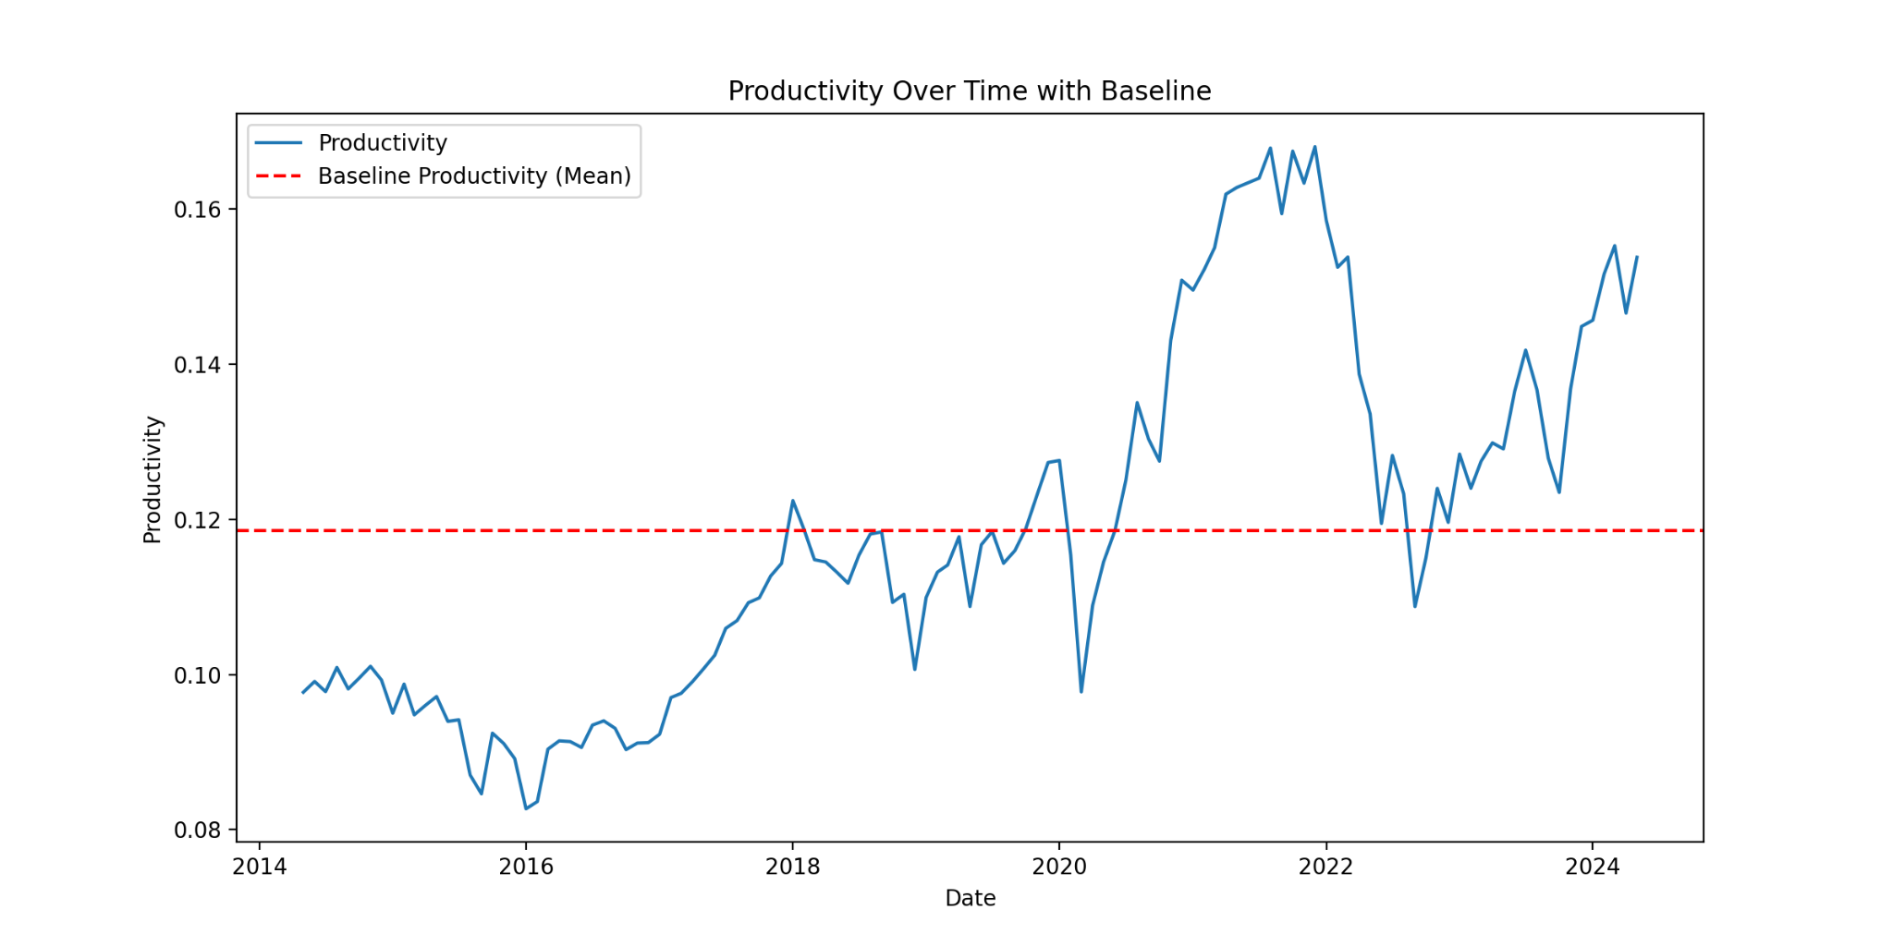
Baseline Productivity: Represented by the red dashed line. This is the mean productivity calculated over a specific stable period.
Observations:
2014-2017: Productivity is mostly below the baseline, indicating periods of lower productivity.
2017-2019: Productivity rises above the baseline, indicating growth.
2019-2021: Increased volatility, but productivity remains above the baseline, suggesting sustained growth despite fluctuations.
2021-2024: Significant periods where productivity is well above the baseline, suggesting periods of strong economic performance

Slide 19
Overall Interpretation
Growth Periods: The periods when the productivity index is above the baseline indicate economic growth. This is observed notably from 2017 onwards, with substantial growth between 2019 and 2024 despite some volatility.
Decline Periods: Periods below the baseline, especially before 2017, indicate relatively lower economic performance or stability.
Volatility: The spikes and drops post-2019 suggest that while there is overall growth, the economic environment has been more volatile.
Insights and Implications
Economic Growth: The overall trend indicates that productivity in the USA has generally increased over the last decade.
Volatility: The increased volatility in recent years could be due to various economic events, policy changes, or external factors influencing the productivity.
Baseline Reference: The baseline serves as a useful reference to gauge the relative performance over time. Periods above the baseline indicate better-than-average performance, while periods below suggest a need for improvement.

Slide 20
Currency Devaluation
To calculate the real currency devaluation, we used a reference currency with flat M1 growth and stable productivity. For this analysis, the reference date was set to August 1, 2021, due to the lack of data for the exact target date. The reference exchange rate was 98.78, while the current exchange rate was 109.58, resulting in a currency devaluation of approximately 10.93%.. This devaluation indicates a weakening of the currency over the specified period, influenced by various economic factors such as changes in money supply, inflation, and market performance.
Currency Devaluation = Current Exchange Rate - Base Exchange Rate x 100
Base Exchange Rate
Reference Date: August 1, 2021
Reference Exchange Rate: 98.78
Current Date: May 1,2024
Current Exchange Rate: 109.58
Currency Devaluation: (109.58−98.78 ) × 100 ≈ 10.93%
98.78
This means the USD has depreciated by approximately 10.93% against the reference currency over the given time period.

Slide 21
Conclusion
This financial analysis provides valuable insights into the relationships between key economic variables and their impact on productivity. The strong correlations observed indicate that an increase in the money supply is associated with positive movements in the stock market and inflation rates. This supports the theoretical framework suggesting that increased money supply leads to currency depreciation and higher inflation.
The productivity model developed highlights the economy's ability to manage resources effectively over time. The observed productivity trends, when compared to the baseline, show periods of economic growth and decline. These insights can inform policymakers and investors about the potential impacts of monetary policies and economic conditions.
The currency devaluation analysis demonstrates the weakening of the currency over the specified period, influenced by various economic factors. This information is crucial for understanding the long-term economic trends and making informed decisions regarding currency management and international trade.

Slide 22
Thank YOU!

